Slide 1
CoreHard: Running an
Engineering Community
Anton Naumovich

Slide 2

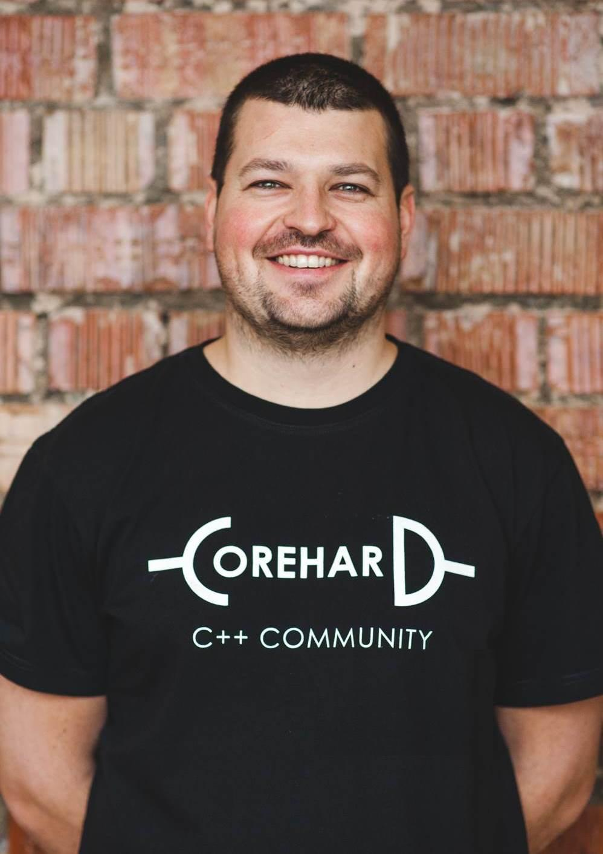


About me
Senior Engineering Manager on Backup, Minsk, Belarus
Worked for Microsoft, Hyper-V in the past
Leader of CoreHard - Belarusian C++ Community
12+ years in engineering and management

Slide 3
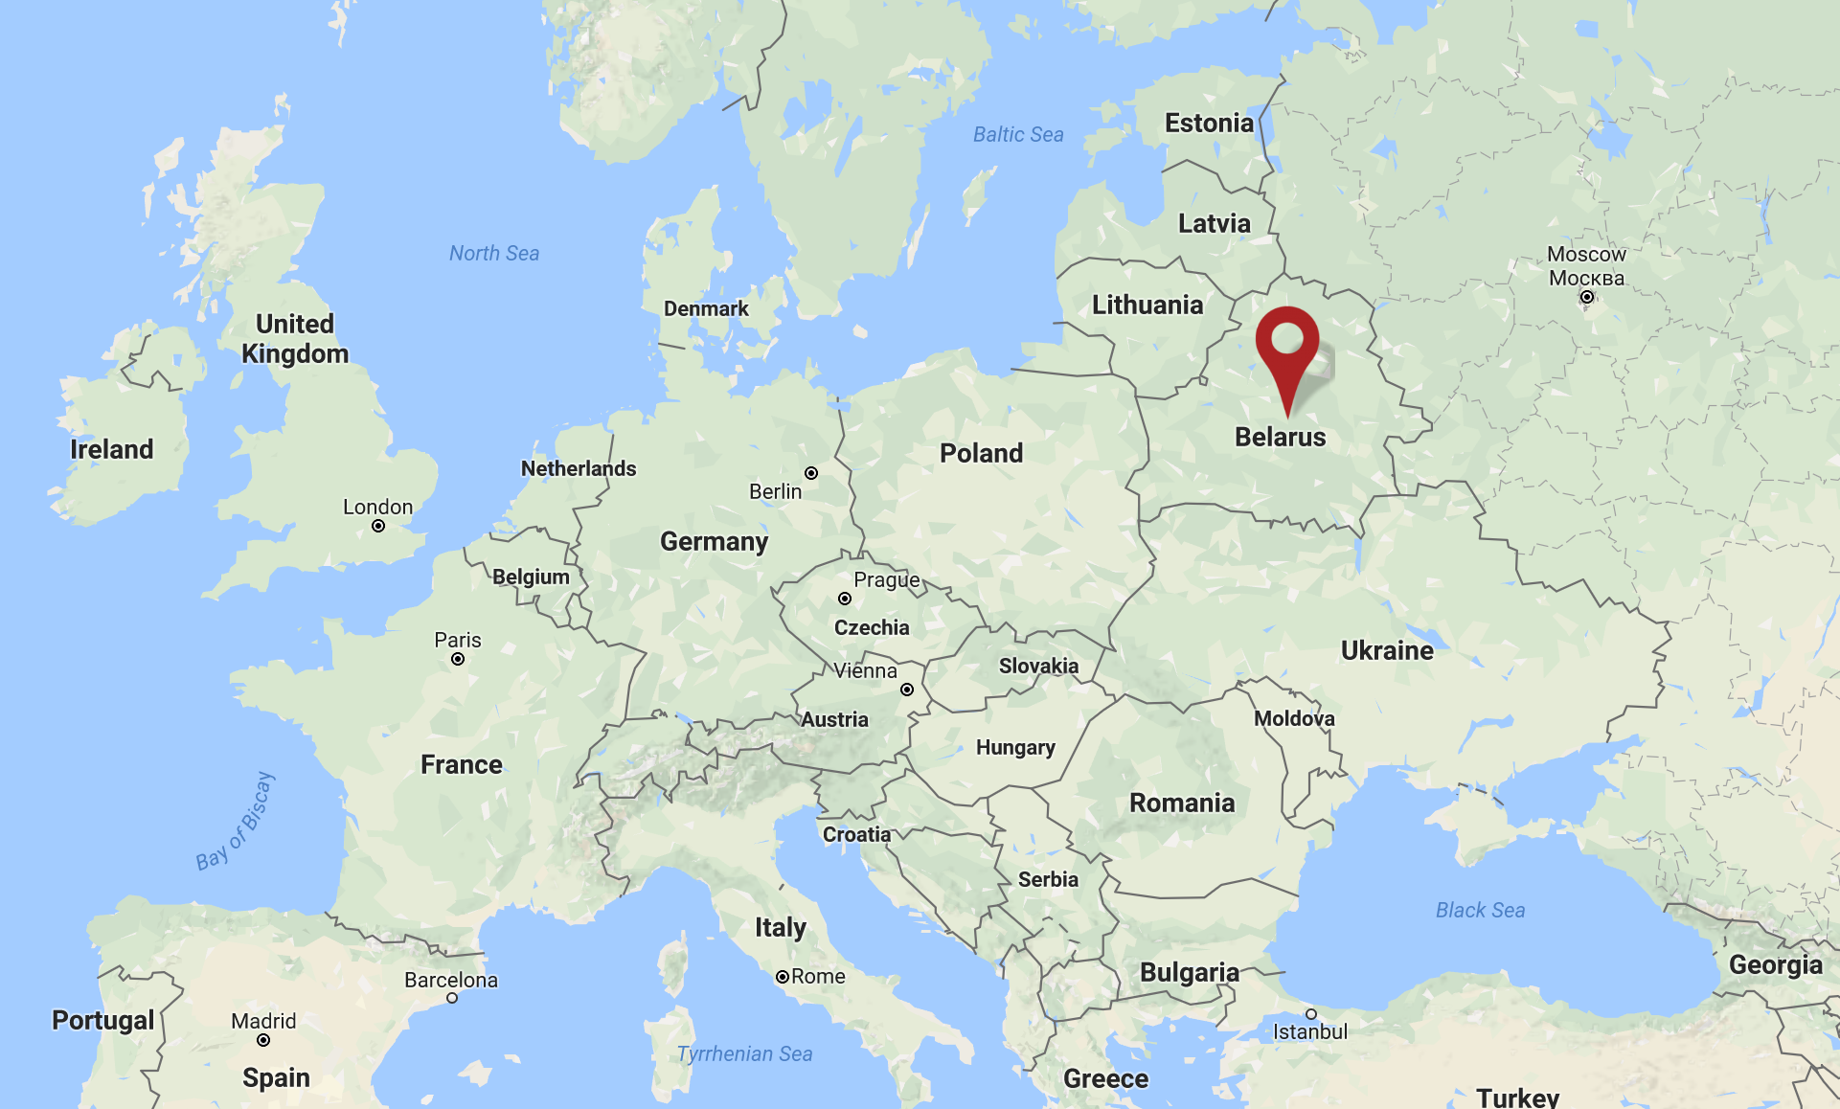

Belarus
Belarus: 10M population
Minsk: 2M population
High-tech park with tax benefits:
1,200+ IT companies
50K+ Employees in IT companies
Home of EPAM, World of Tanks, Viber, MSQRD
Five days Visa-free entry

Slide 4

Quick facts about CoreHard
Idea to create a local C++ user group
Two years old (started in 2015, first conference gathered 50 participants)
Dedicated C++ CoreHard conference
Hosted seven conferences so far; eighth on its way in April 2018
Audience: 1k+ engineers
Speakers from Belarus, Russia, Ukraine, Israel, Serbia, Sweden
Member of worldwide user groups list, community-sponsoring CppCon

Slide 5
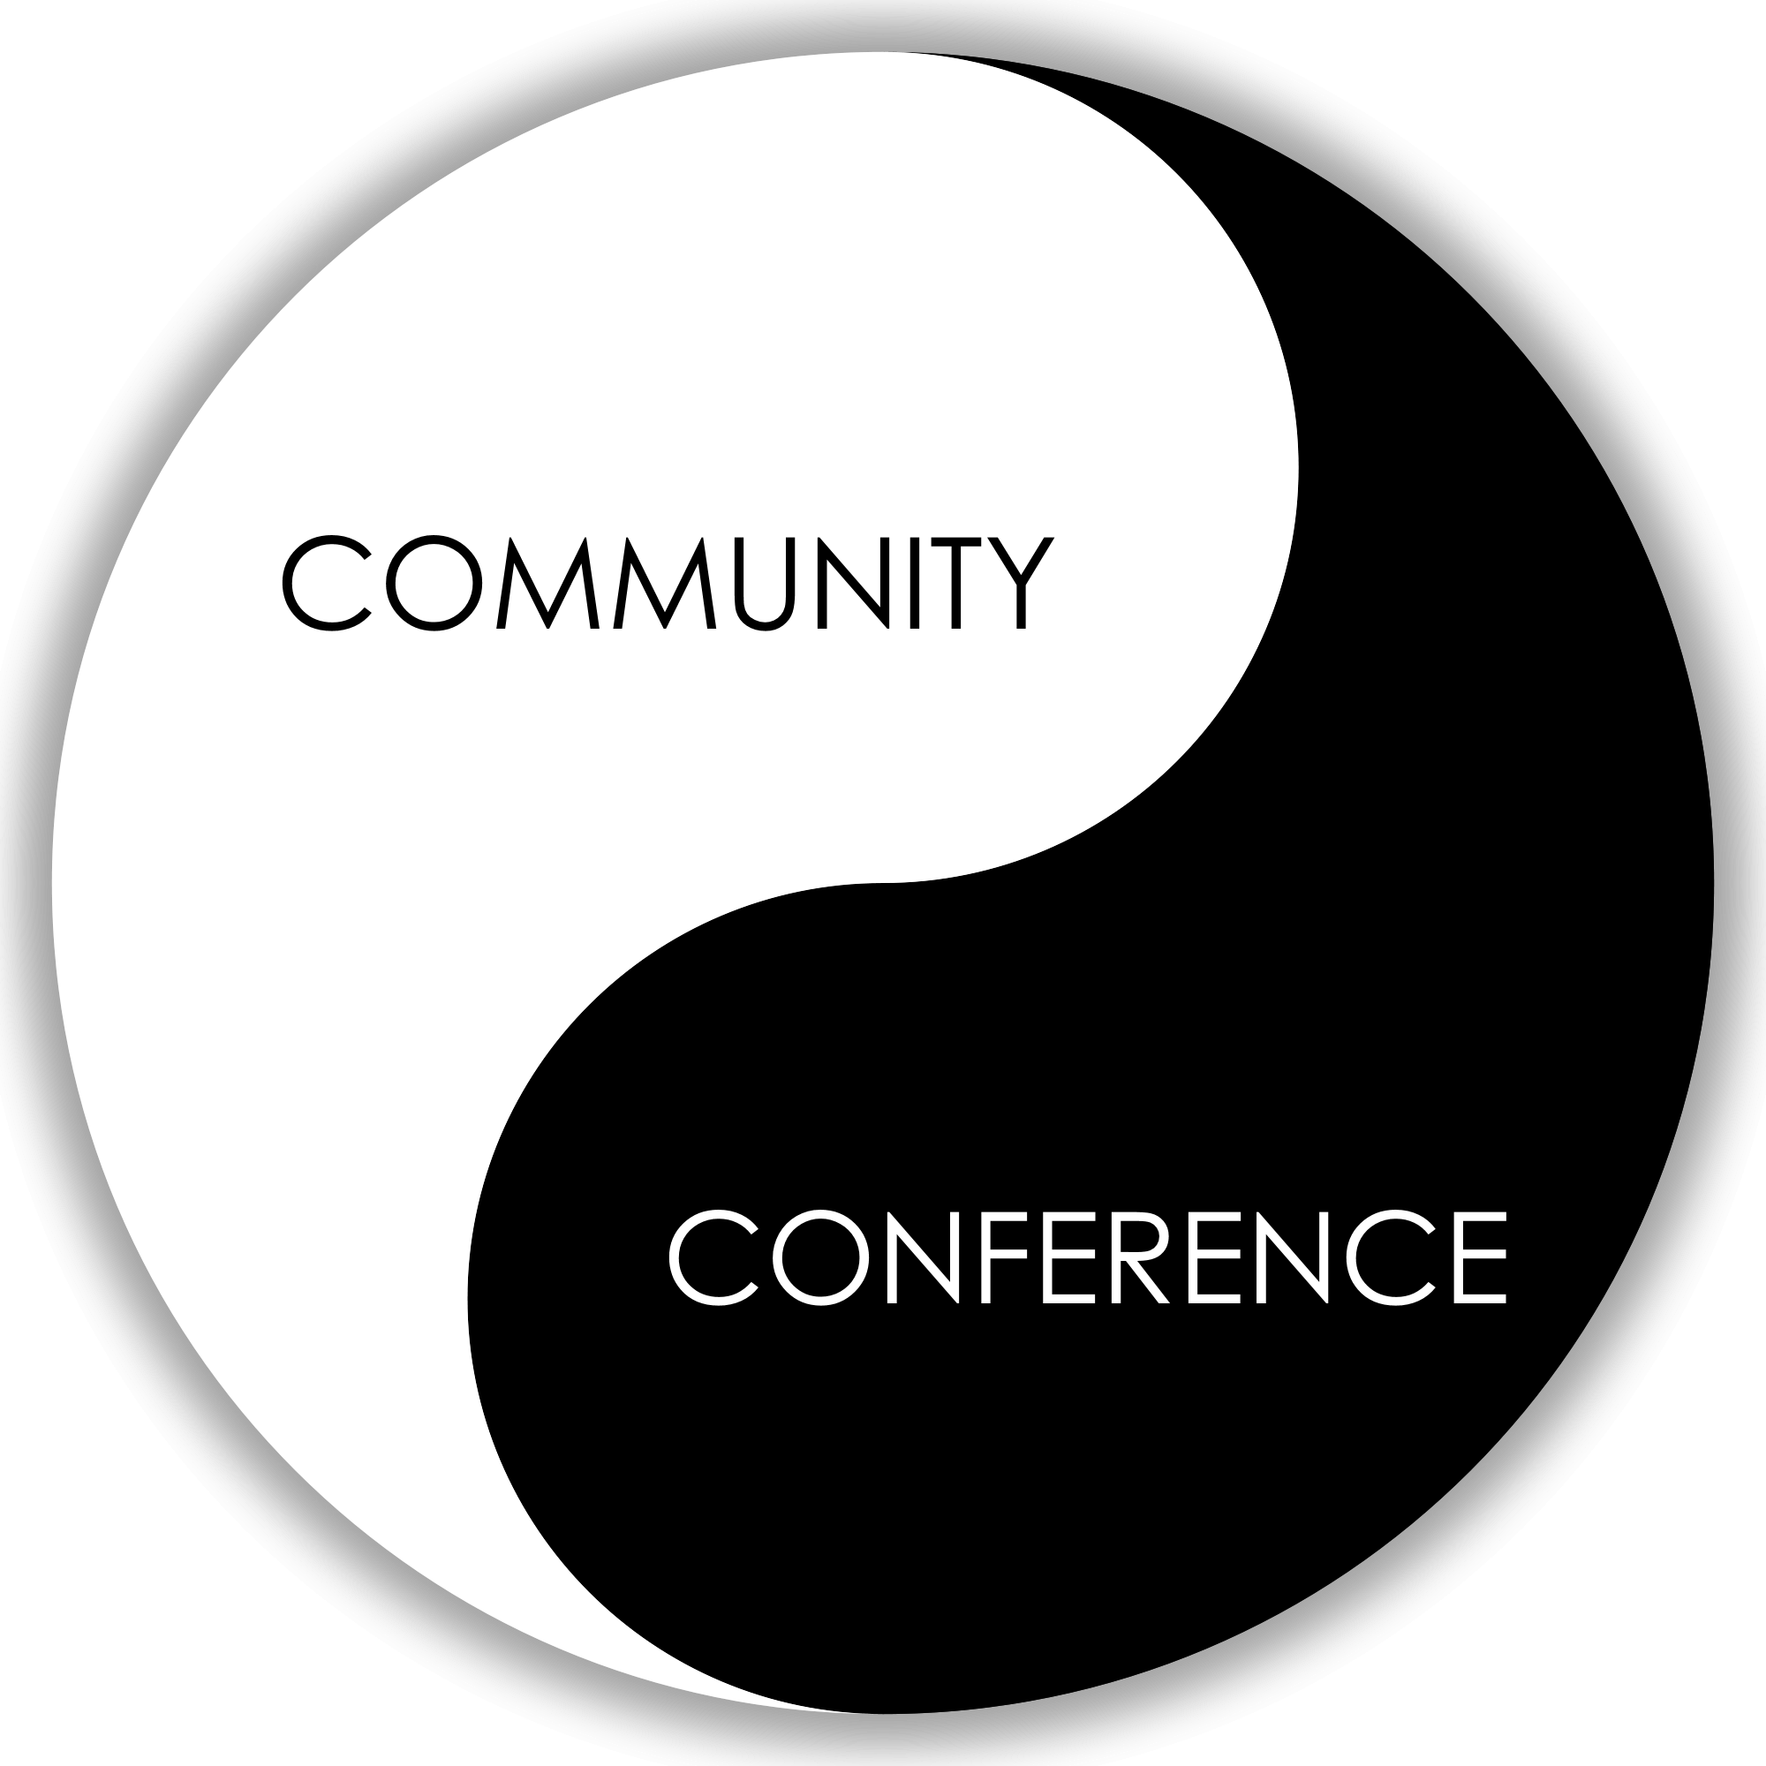
Tip #0. Community = Communication
Face-to-face communication
Conferences/meetups

Slide 6
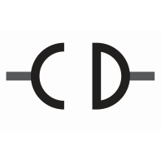
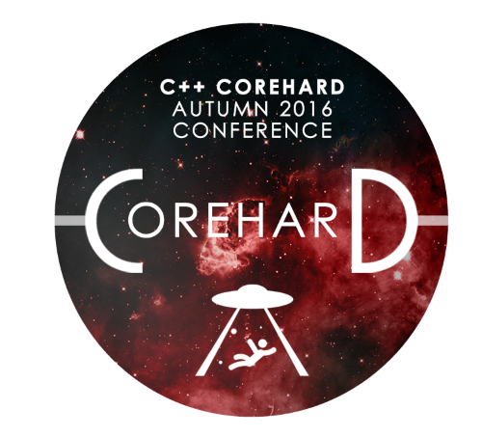


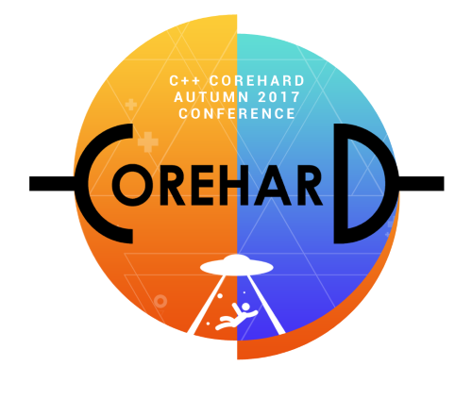
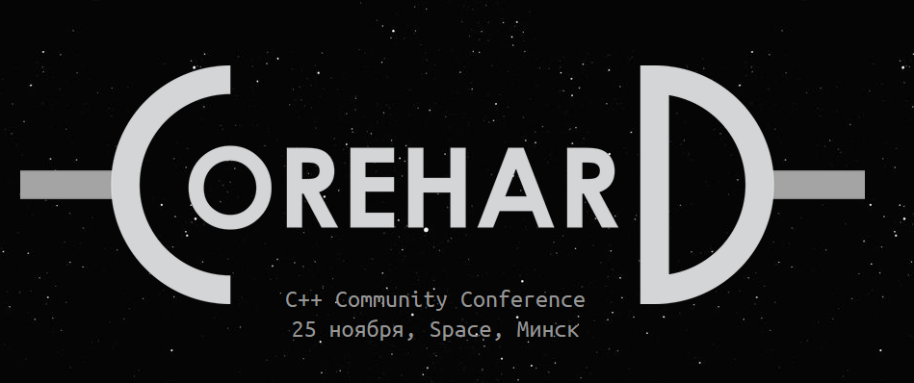


Tip #1. Naming and branding

Slide 7
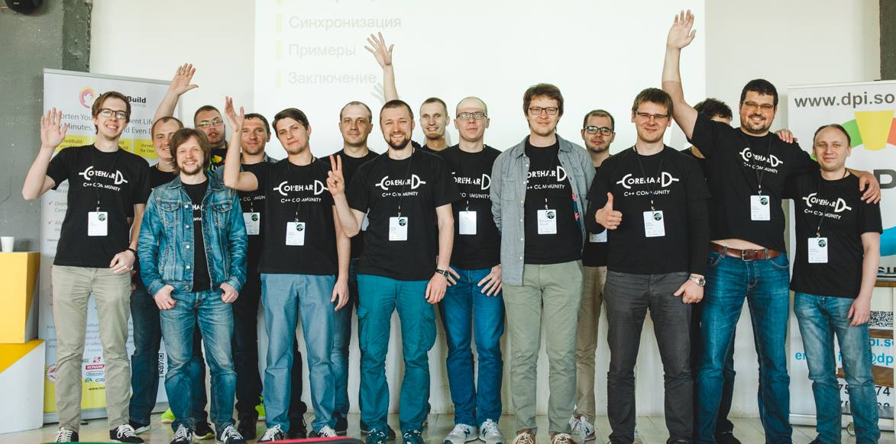
Tip #2. Getting the audience
Free events attract larger audience—and more unpredictable, of course
Recorded videos of talks from past events on YouTube®
Live streaming of the events
Photos from the conferences in social networks

Slide 8
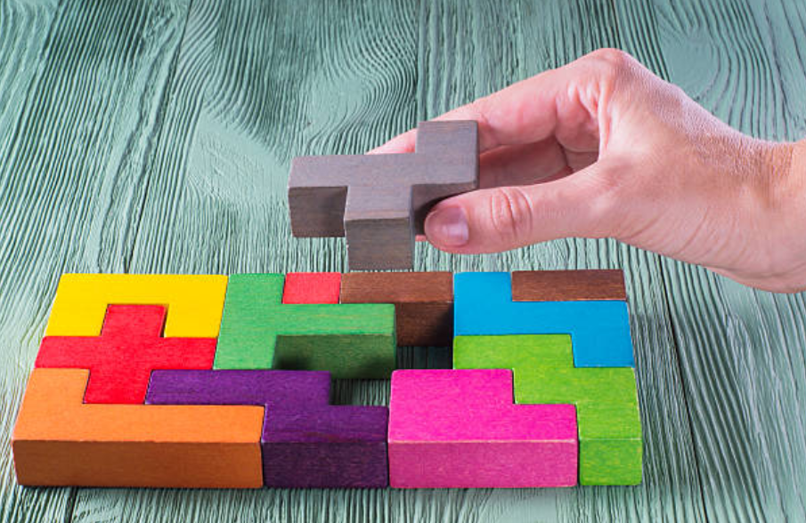
Tip #3. Keeping community open
Community is a crystallization spot
A community should attract “fresh blood”:
To gather a critical mass
To keep running
“Non-professional” speakers burn out the content fairly quickly

Slide 9
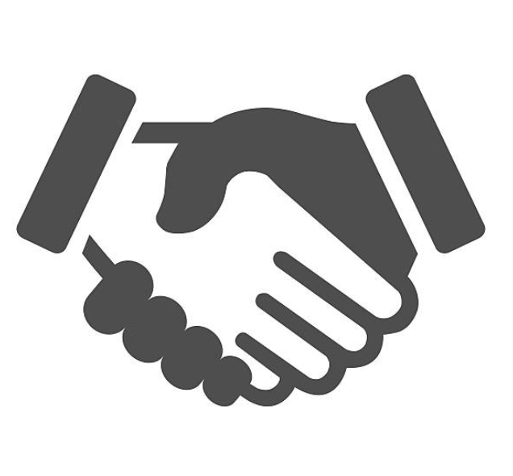
Tip #4. Connect with co-communities and conferences
Get recognition and better search ranking by connecting with mates, for us worked:
C++ Russia - C++ community/conference in CIS
CppCon - Woodstock of C++
MeetingCpp - largest European C++ conference
isocpp.org - C++ standardization committee
That’s usually a win-win game

Slide 10
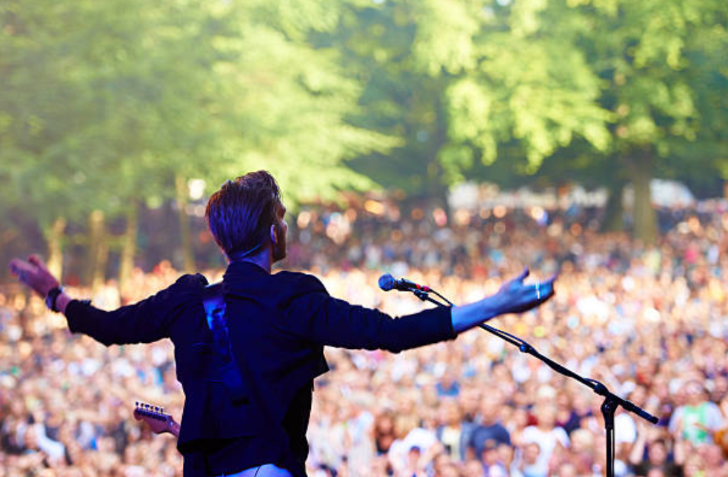
Tip #5. Rockstar speakers
Authors of famous books
Maintainers of libraries/tools (open source or not only)
People involved into standardizations activities
Godfathers of industry/languages
CTOs, CEOs, architects

Slide 11
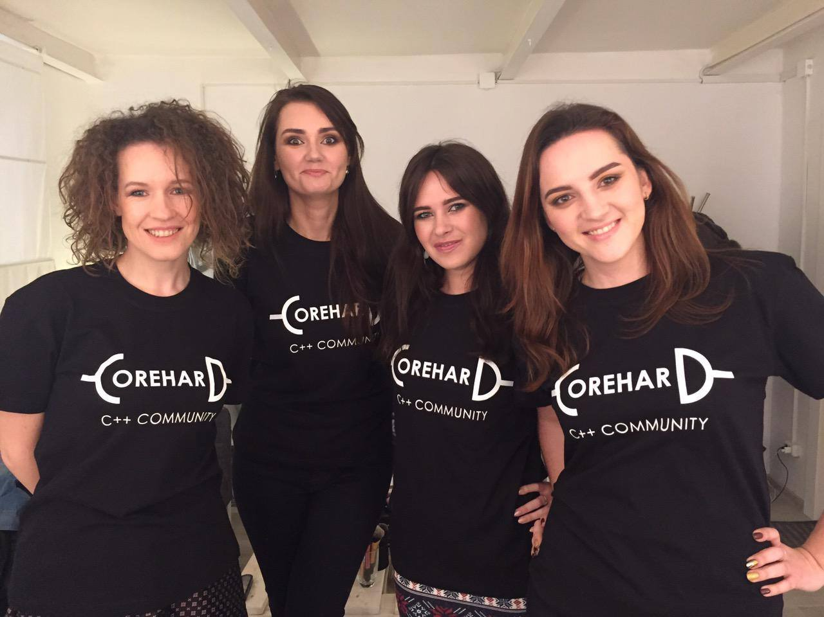
Tip #6. Promotion and socialization
Community / conference websites
Social networks
YouTube
IM channels
Many more

Slide 12
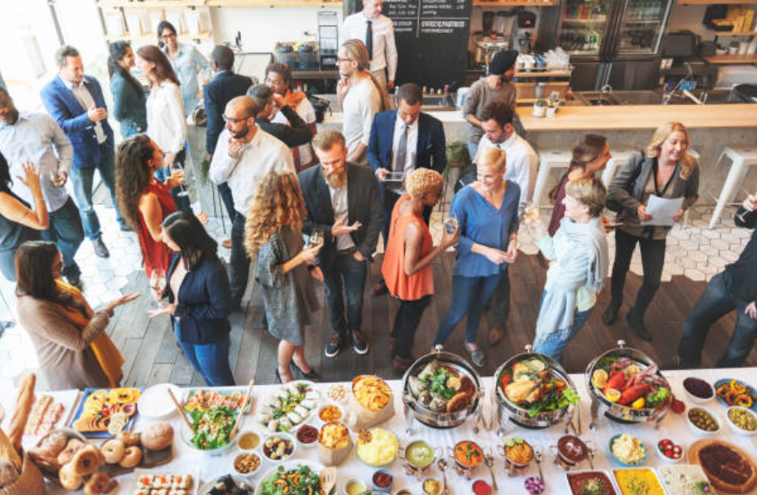
Tip #7. After parties!

Slide 13

Company benefits
Local company recognition (“break the ice”)
Appreciation and respect by engineers for supporting the movement
PR via company speakers
Informal connections with engineers from other companies
Encourage innovations in the company: Idea -> Talk (POC) -> Implement
Team building/motivation and uniting idea
Exchange experience

Slide 14
Want to be a part of the community?
meetup.com has plenty of meetups/conferences/user groups
Join or start one!

Slide 15
Thanks!
Thank you! Any questions?
Anton.Naumovich@solarwinds.com
corehard.by
conference.corehard.by

Slide 16
The SolarWinds, SolarWinds & Design, Orion, and THWACK trademarks are the exclusive property of SolarWinds Worldwide, LLC or its affiliates, are registered with the U.S. Patent and Trademark Office, and may be registered or pending registration in other countries. All other SolarWinds trademarks, service marks, and logos may be common law marks or are registered or pending registration. All other trademarks mentioned herein are used for identification purposes only and are trademarks of (and may be registered trademarks) of their respective companies.

